Slide 1
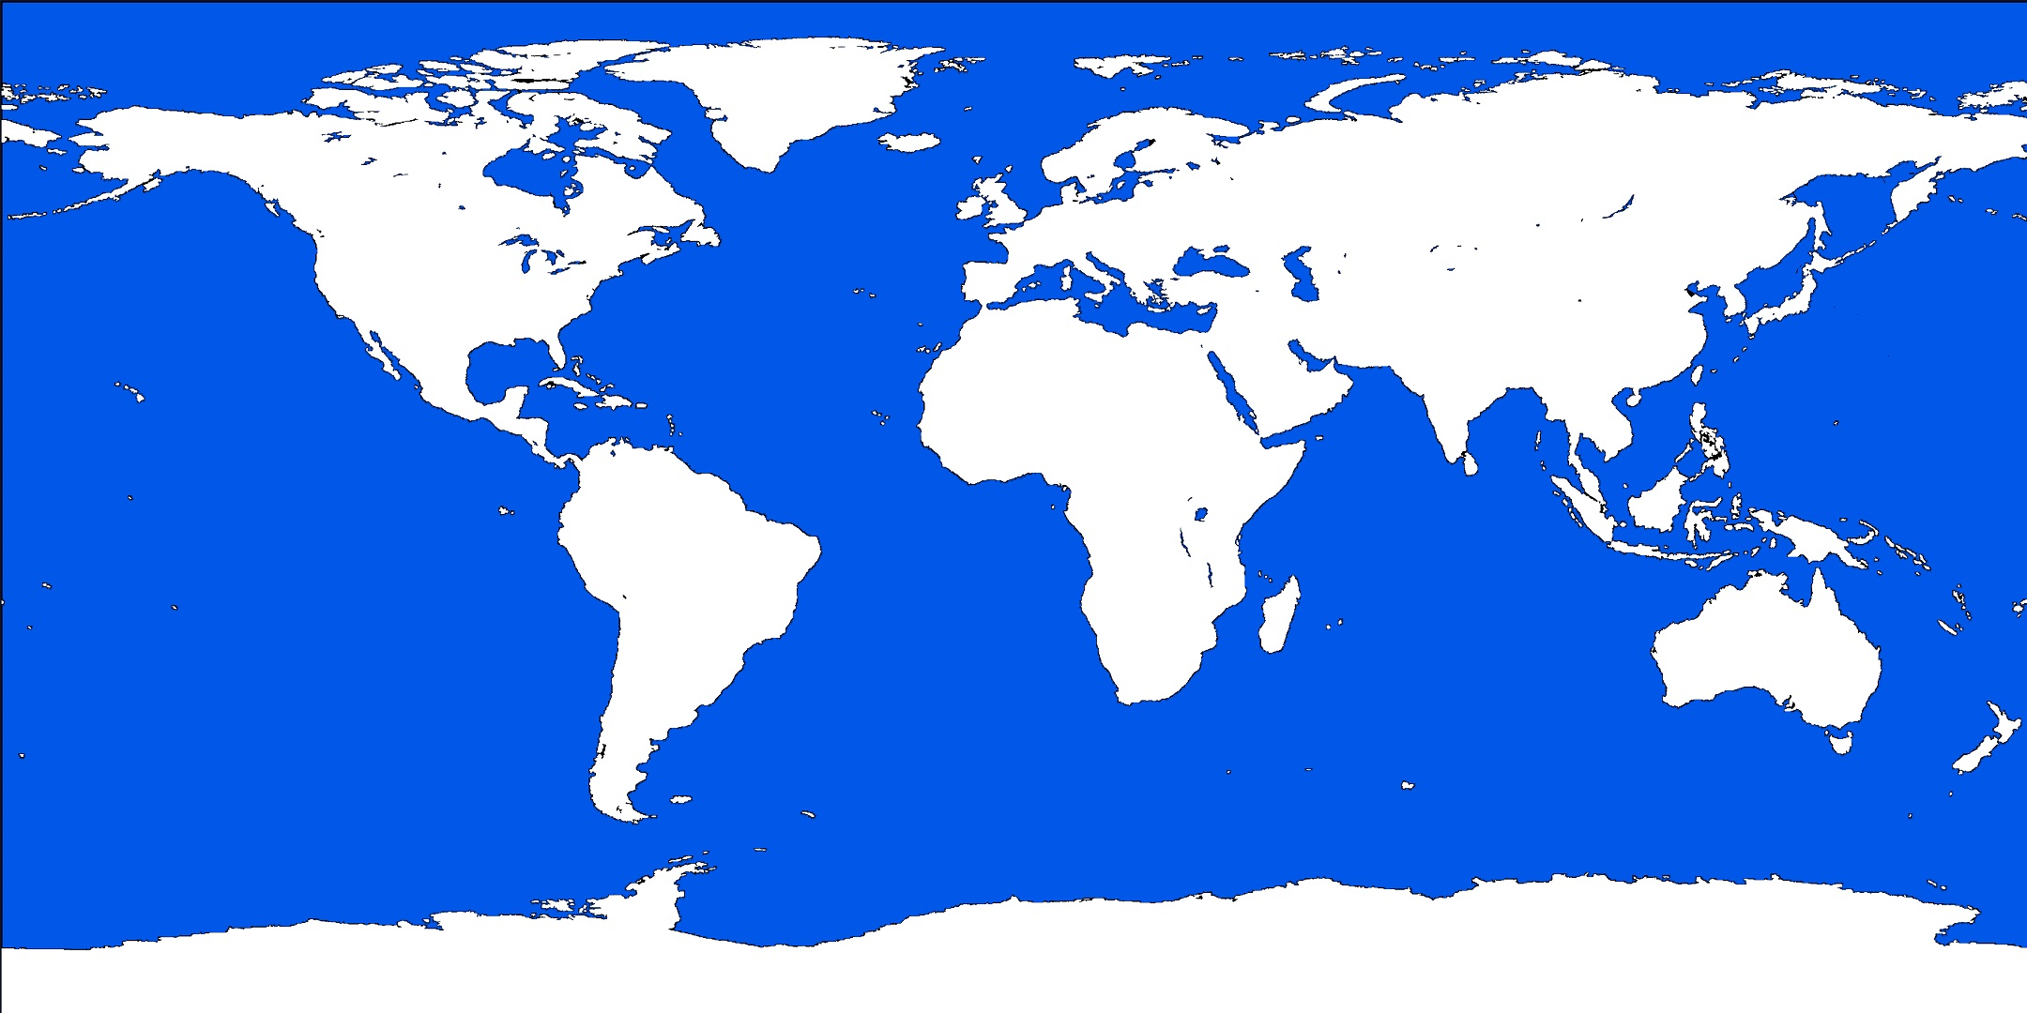
GeMMS and MQDSS
Round 2 Multivariate Digital Signature Candidates

Slide 2
GeMMS – Based on HFEv-
Multivariate scheme based on HFEv-. Inspired by the QUARTZ scheme of CT-RSA 2001, but better.
“Big Field” scheme, using a tower of extension fields to construct a hidden map.
Basic idea first published by Patarin in 1998.
Another first round candidate that did not make the cut, Gui, is substantially similar.
GeMMS retains the conservative parameter selections of round one, but at our request, also provides parameters leaning in the direction of the Gui submission, enhancing performance.

Slide 3


HFEv- Construction
Let $𝔼$ be a degree $n$ extension of $𝔽$.
HFEv map:
Let $T,U$ be affine maps of the appropriate dimension and let $Π$ be a corank $Δ$ projection.
The public key is given by $𝒫\left(x\right)=Π∘T∘ℱ∘U(x)$.

Slide 4
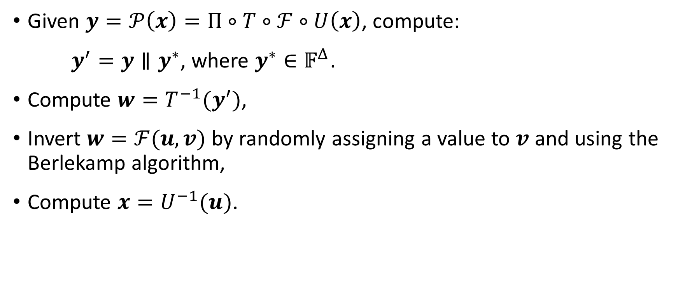
Inversion
Given $y=𝒫\left(x\right)=Π∘T∘ℱ∘U\left(x\right)$, compute:
$y^{′}=y∥y^{∗}$, where $y^{∗}∈𝔽^{Δ}$.
Compute $w=T^{−1}(y^{′})$,
Invert $w=ℱ(u,v)$ by randomly assigning a value to $v$ and using the Berlekamp algorithm,
Compute $x=U^{−1}(u)$.

Slide 5
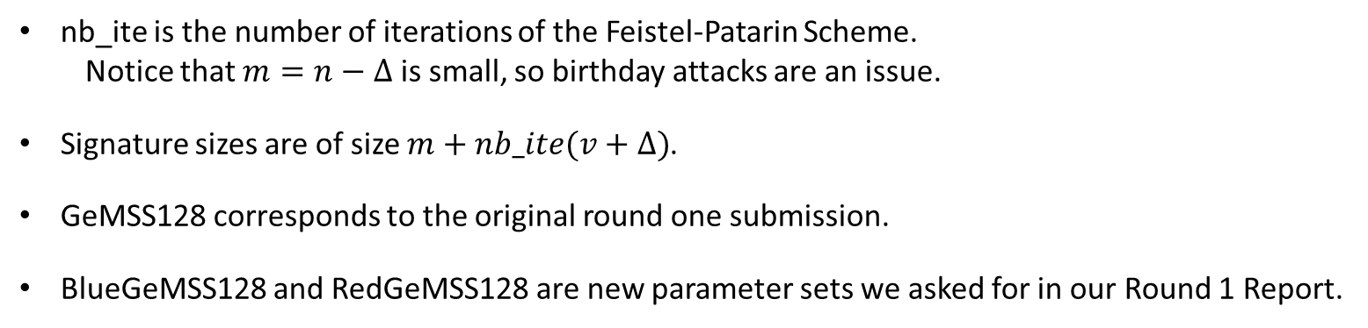
Parameter Explanation
nb_ite is the number of iterations of the Feistel-Patarin Scheme.
  Notice that $m=n−Δ$ is small, so birthday attacks are an issue.
Signature sizes are of size $m+nb_ite(v+Δ)$.
GeMSS128 corresponds to the original round one submission.
BlueGeMSS128 and RedGeMSS128 are new parameter sets we asked for in our Round 1 Report.

Slide 6
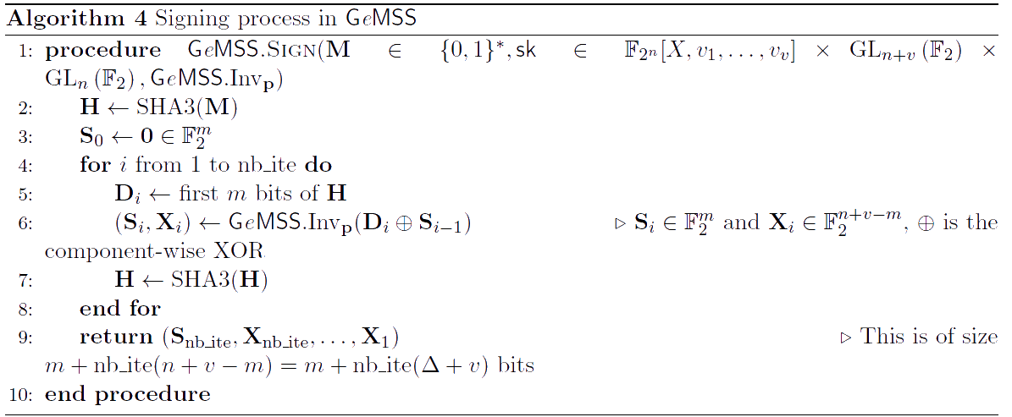
Signature Generation

Slide 7
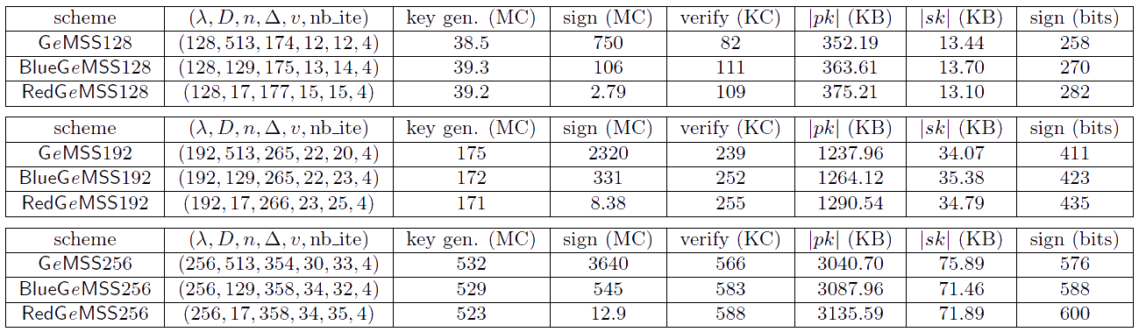
GeMSS Parameter Sets

Slide 8
GeMSS Security Analyses
Direct Inversion by Exhaustive Search
Direct algebraic attack via Groebner bases
Classical and Quantum Boolean Solve
Distinguishing Attacks using Groebner bases
Kipnis-Shamir Attack
MinRank Attack using Projections
Differential Attacks

Slide 9
GeMSS EUF-CMA Security
Provides an outline of a proof of EUF-CMA security based on the method of Sakumoto, Shirai, Hiwatari.
The selected parameters do not adhere to this proof because of the cost.
The proof is not particularly tight and there are already arguments that make the proof tighter.
To match the current state-of-the-art, the number of iterations should be about 30 instead of 4 for the proof to be valid.

Slide 10
GeMSS Changes from Round 1
Added the Blue and Red parameter sets.
Include a sparse version and a one-parameter version.
Improve certain algorithms

Slide 11
MQDSS
Provably secure multivariate signature scheme based on a 5-pass identification scheme
Identification scheme has security depending directly on the MQ Problem (NP-complete).

Slide 12
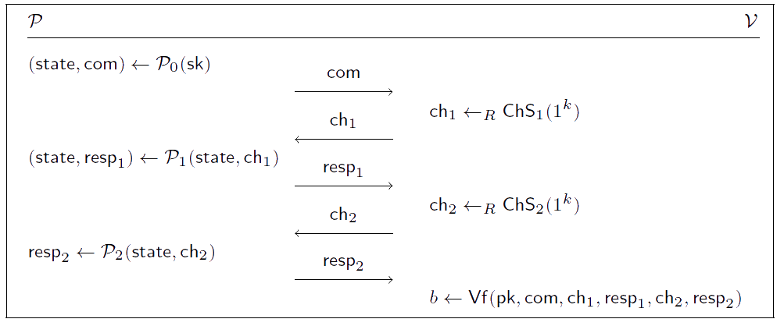
MQDSS

Slide 13
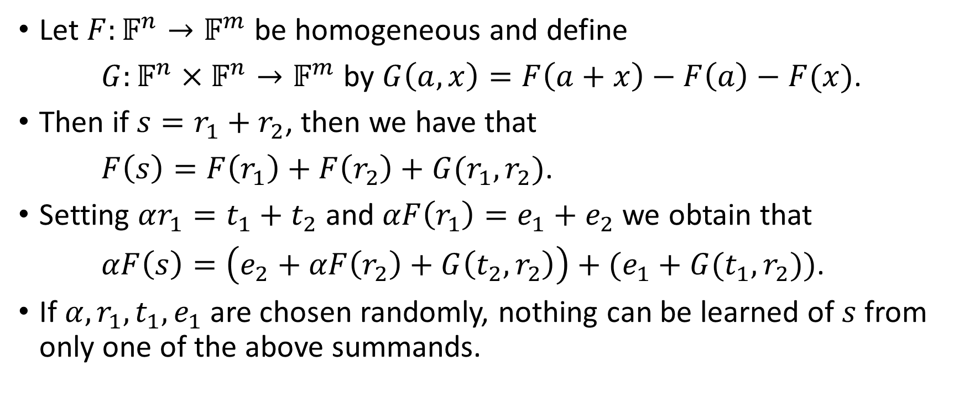
Identification Scheme Observation
Let $F:𝔽^{n}→𝔽^{m}$ be homogeneous and define
$G:𝔽^{n}×𝔽^{n}→𝔽^{m}$ by $G\left(a,x\right)=F\left(a+x\right)−F\left(a\right)−F(x)$.
Then if $s=r_{1}+r_{2}$, then we have that
$F\left(s\right)=F\left(r_{1}\right)+F\left(r_{2}\right)+G(r_{1},r_{2})$.
Setting $αr_{1}=t_{1}+t_{2}$ and $αF\left(r_{1}\right)=e_{1}+e_{2}$ we obtain that
$αF\left(s\right)=\left(e_{2}+αF\left(r_{2}\right)+G\left(t_{2},r_{2}\right)\right)+(e_{1}+G(t_{1},r_{2}))$.
If $α,r_{1},t_{1},e_{1}$ are chosen randomly, nothing can be learned of $s$ from only one of the above summands.

Slide 14
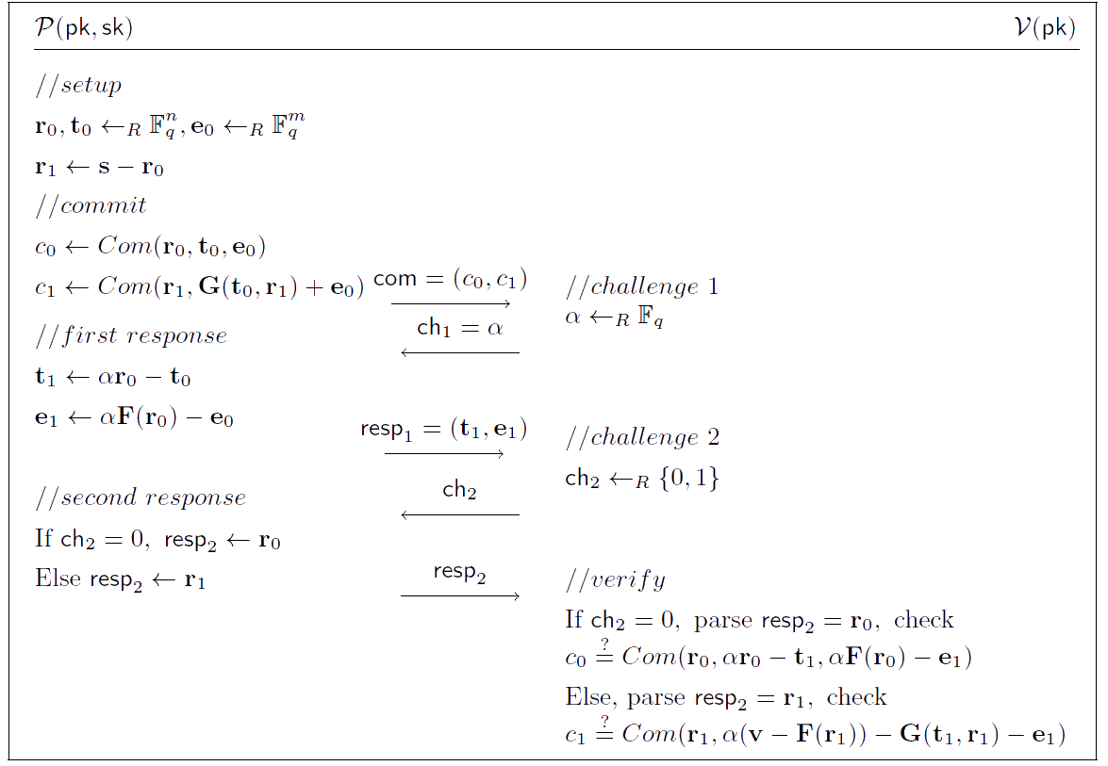
The Sakumoto, Shirai, Hiwatari 5-Pass IDS

Slide 15
Fiat-Shamir Transform for 5-pass IDS schemes
They generalize the EUF-CMA security reduction provided for 3-pass IDS by Fiat-Shamir to a new version of Fiat-Shamir for 5-pass schemes
This is previously published work. (They include the security reduction in Appendix A of the supporting documentation.

Slide 16
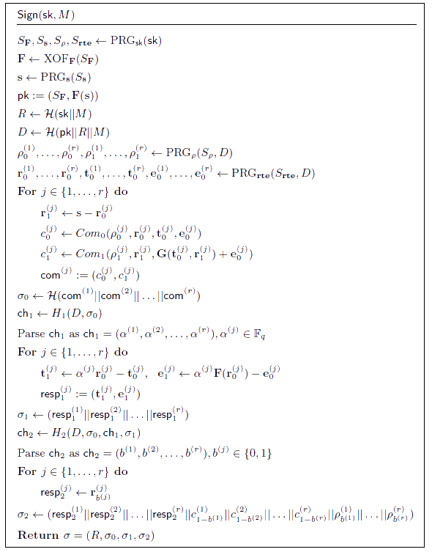
MQDSS Signature Generation (simple)

Slide 17
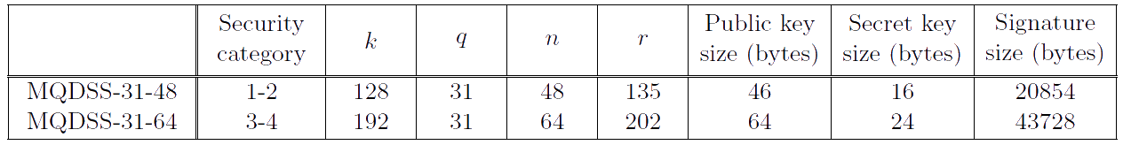
MQDSS Parameter Sets

Slide 18
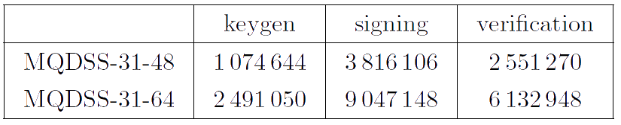
Performance on x64-86 AVX2

Slide 19
MQDSS Security Analyses
Attacks target either MQ, hash functions or commitments
Consider direct attacks using Groebner bases and other generic algorithms, such as Crossbred (Crossbread?)

Slide 20
MQDSS Changes From Round 1
Tweaked the commitment functions to make them computationally hiding
Reduced the number of rounds by 50%
  Signature sizes reduced by 35%
  Signing and Verification 40-50% faster
Cleaned up their analysis on the generic complexity of MQ.
Included many new parameter sets for study over various other fields.

